Slide 1
TRAUMATOLOGY

Slide 2
FRACTURES

Slide 3
DEFINITION
Break or loss of continuity of bone architect.
Break in continuity of a bone.

Slide 4
CLASSIFICATION
ACCORDING TO AETIOLOGY
Fractures caused solely by sudden injury
Flagility fractures
Fatigue fractures
Pathological fracture
2. DEPENDING ON COMMUNICATION WITH SKIN
OR EPITHELIUM
Closed fractures
Open(compound) fractures

Slide 5
FRACTURES CAUSED SOLELY BY SUDDEN INJURY
They form the largest group
Occur in a bone that was previously healthy
Such fractures may be caused by:
Direct violence; e.g. when a metatarsal bone is fractured by a heavy weight dropped on the foot
Indirect violence transmitted along the bone; e.g. when head of radius is fractured in a fall on outstretched hand, or the clavicle in a fall on the shoulder.

Slide 6
FRAGILITY FRACTURES
They are associated with generalized bone weakness resulting from osteoporosis as commonly seen in elderly patients

Slide 7
FATIGUE FRACTURES
They occur due to repeated stress.
Commonly seen in athletes and military recruits.
Occur when the rate of micro damage exceeds the rate of repair.
Majority occur in the metatarsal but may involve other sites such as the fibula, shaft of tibia and neck of femur

Slide 8
PATHOLOGICAL FRACTURES
They occur in bones already weakened by disease
A fracture is pathological if it is created by a level of force that would not have resulted in a fracture in a healthy bone
Often the bone gives way from trivial violence or spontaneously

Slide 9
CLOSED/SIMPLE FRACTURE
It’s a fracture where there is no communication between the site of fracture and the skin or epithelium

Slide 10
OPEN/COMPOUND FRACTURE
It is a fracture where there is communication with the skin surface or epithelia e.g. intestinal mucosa, cranial sinuses and pleural space.
The communication may be through an open wound,, but it may be no more than a puncture wound or even an area of bruised and devitalized skin.
Open fractures are liable to contamination by organisms introduced from without and hence become infected.

Slide 11
PATTERNS OF FRACTURES
There are seven patterns of fractures namely:
Transverse
Oblique
Spiral
Comminuted
Greenstick
Compression
Impacted

Slide 12
Cont’d
TRANSVERSE FRACTURES
Occur as a result of mild to moderate direct force and avulsion(pulling/tension) force.

Slide 13
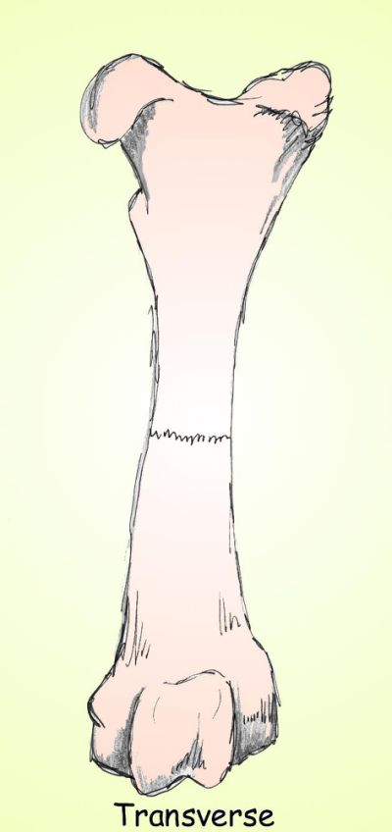
Transverse fracture

Slide 14
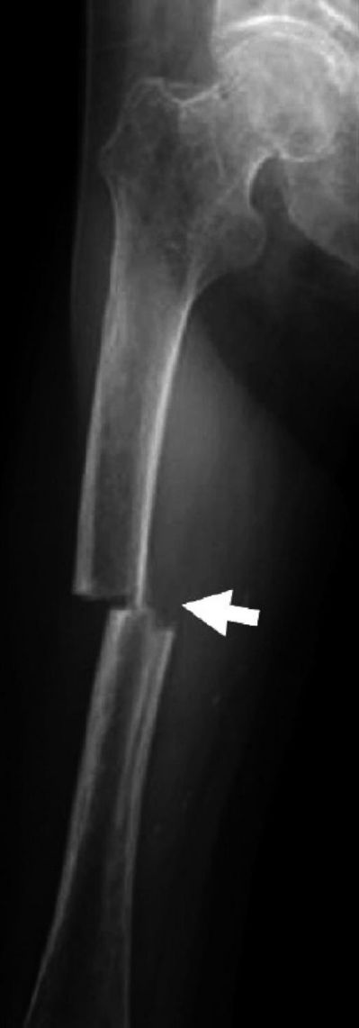
Transverse fracture of femur

Slide 15
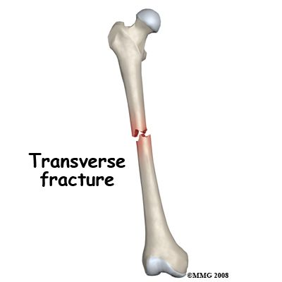
TRANVERSE FRACTURE OF FEMUR

Slide 16
Cont’d
2) OBLIQUE FRACTURE
Occur as a result of compression force

Slide 17
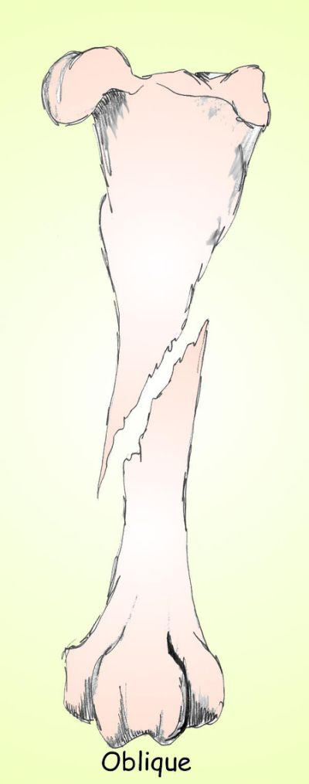

Slide 18
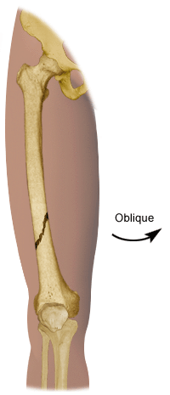
Oblique fracture of femur

Slide 19
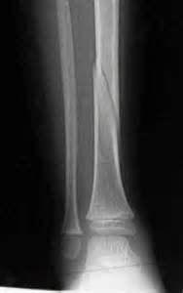
Oblique fracture of tibia

Slide 20
Cont’d
3) SPIRAL FRACTURE
Occurs as a result of twisting force

Slide 21
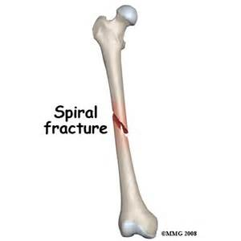
Spiral fracture of mid shaft femur

Slide 22
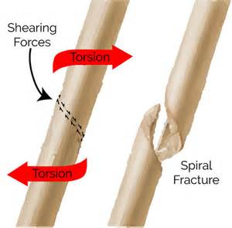
Spiral fracture

Slide 23
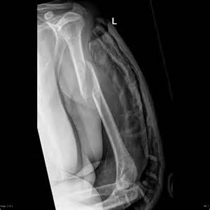
Spiral fracture of proximal humerus

Slide 24
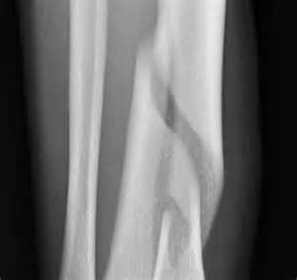
Spiral fracture of tibia

Slide 25
Cont’d
4) COMMINUTED FRACTURE
It’s a fracture whereby there are more than two bone fragments
Occurs as result of severe or excessive force

Slide 26
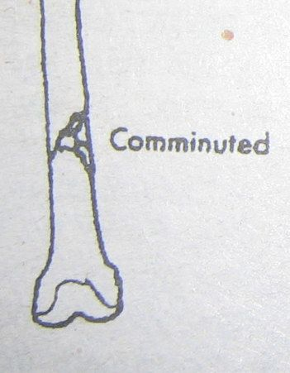
Comminuted fracture

Slide 27
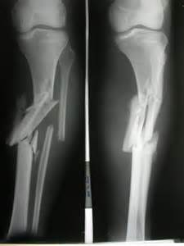
Comminuted fracture of tibia

Slide 28
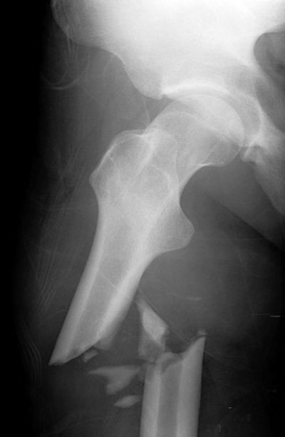
Comminuted fracture of proximal femur

Slide 29
Cont’d
5) GREENSTICK FRACTURE
Occur in children especially below the age of 10 years due to flexibility of their bones.
There is breakage or minimal breakage in one of the cortex of the affected bone

Slide 30
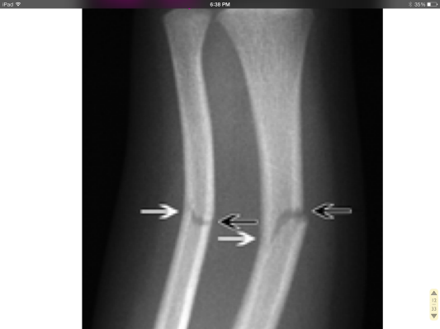
Greenstick fractures of radius and ulna

Slide 31
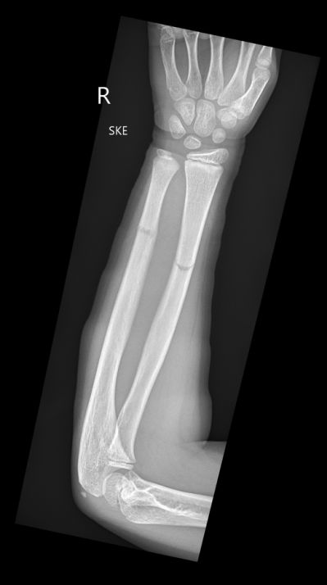
Greenstick fractures of radius and ulna

Slide 32
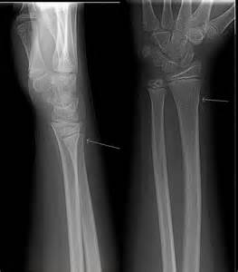
Greenstick fractures of radius and ulna

Slide 33
Cont’d
6) COMPRESSION FRACTURE
Mostly occur in bodies of the vertebrae.
Caused by excess flexion or axial loading on the spine.

Slide 34
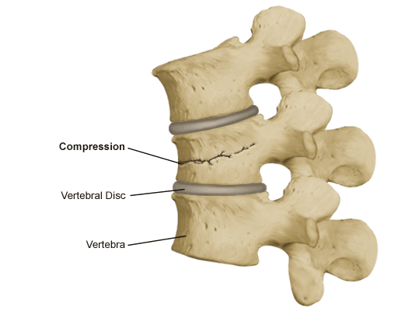
Compression fracture

Slide 35
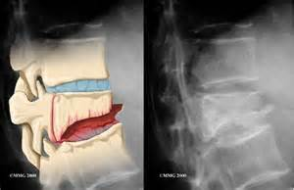
Compression fracture

Slide 36
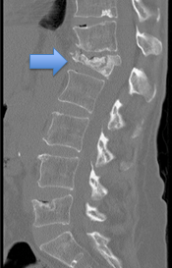
MRI showing compression fracture

Slide 37
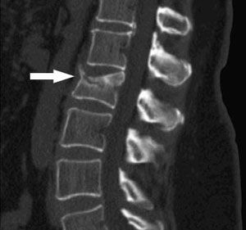
MRI showing compression fracture

Slide 38
Cont’d
7) IMPACTED FRACTURES
Fractures in which the bone fragments are driven so firmly together that they become interlocked and there is no movement between them

Slide 39
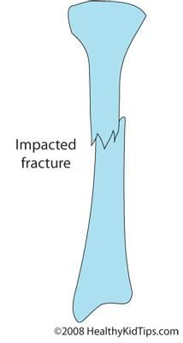

Slide 40
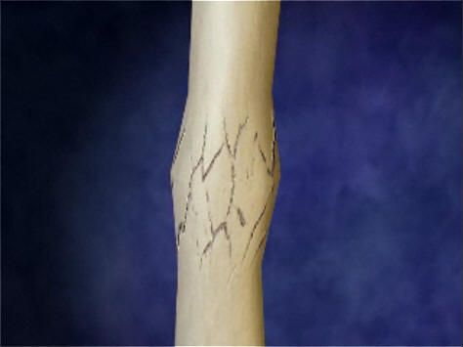
Impacted fracture

Slide 41
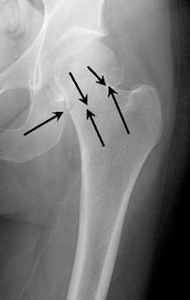
Impacted fracture of neck of femur

Slide 42
DISPLACEMENT IN FRACTURES
In fractures, the proximal fragment is stationary whereas the distal fragment is mobile(movable)
Displacement of fractures depends on the following:
Force of the trauma
Action of muscles
Effect of gravity

Slide 43
TYPES OF DIPLACEMENTS
Translation/distraction
- It can be anteriorly, posteriorly, laterally or
medially
2) Angulation- Caused by bending forces
3) Overlapping- occurs in bones sandwiched
between two strong antagonizing muscles
such as the femur.
4) Rotation- Caused by twisting forces

Slide 44
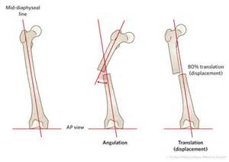
Fracture displacements

Slide 45
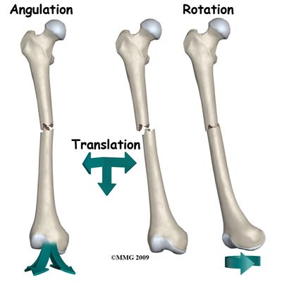
Displacements

Slide 46
Translation

Slide 47
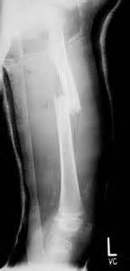
Overlapping

Slide 48
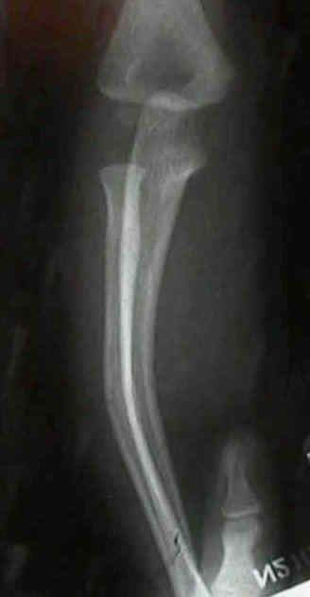
Angulation

Slide 49
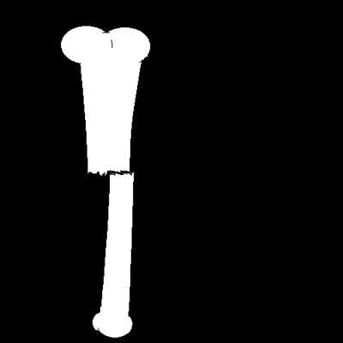
Rotation

